Slide 1
SPECIAL USE PERMIT CASE NUMBER WSUP20-0023
(Burns Family Grading)
Washoe County Board of Adjustment
February 4, 2021

Slide 2
Request
Major grading, including previous unpermitted grading and earthwork totaling approximately 1,500 cubic yards of excavation, and disturbance of a total area of approximately 187,308 square feet (approximately 4.3 acres).
Special Use Permit is the means by which unpermitted grading can be permitted.

Slide 3
Vicinity Map

Slide 4
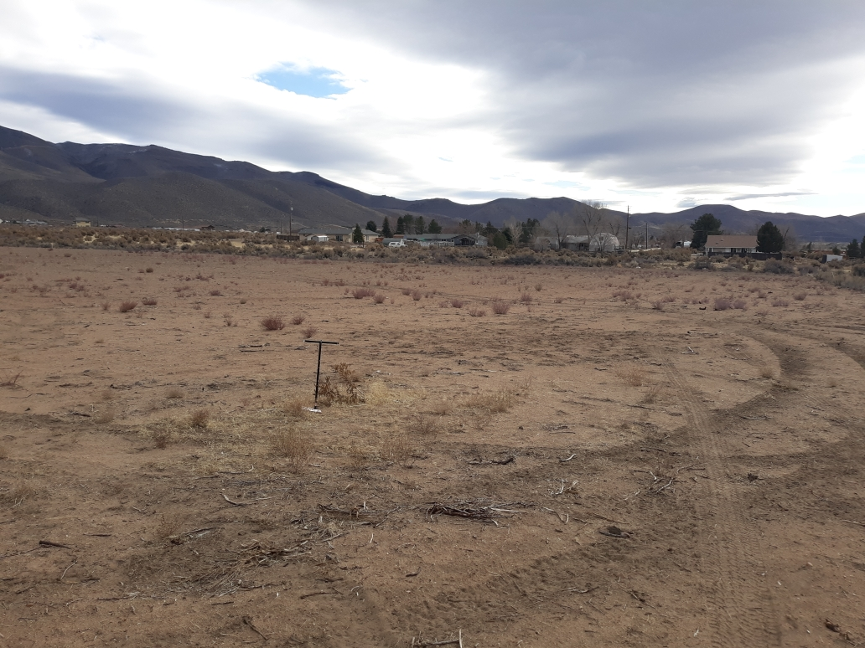
Site Photo

Slide 5
Proposed Grading
The subject site is essentially flat.
The topography of the site is proposed to be returned to as close as possible to a pre-disturbance condition after the permitted grading and restoration is completed.
Conditions of approval include:
  Providing complete grading plans in accordance with the requirements of Article 438.
  Allowing a maximum slope of 4 horizontal to 1 vertical (4:1), within 50 feet of the perimeter of the site, as well as adjacent to the drainage way.
  Relocating all piled soil and plant material back across the graded area.
  Providing revegetation efforts and temporary irrigation to ensure that the disturbed area is stabilized.
  Providing financial assurances to ensure that revegetation grows and thrives.
  Control of noxious weeds.

Slide 6
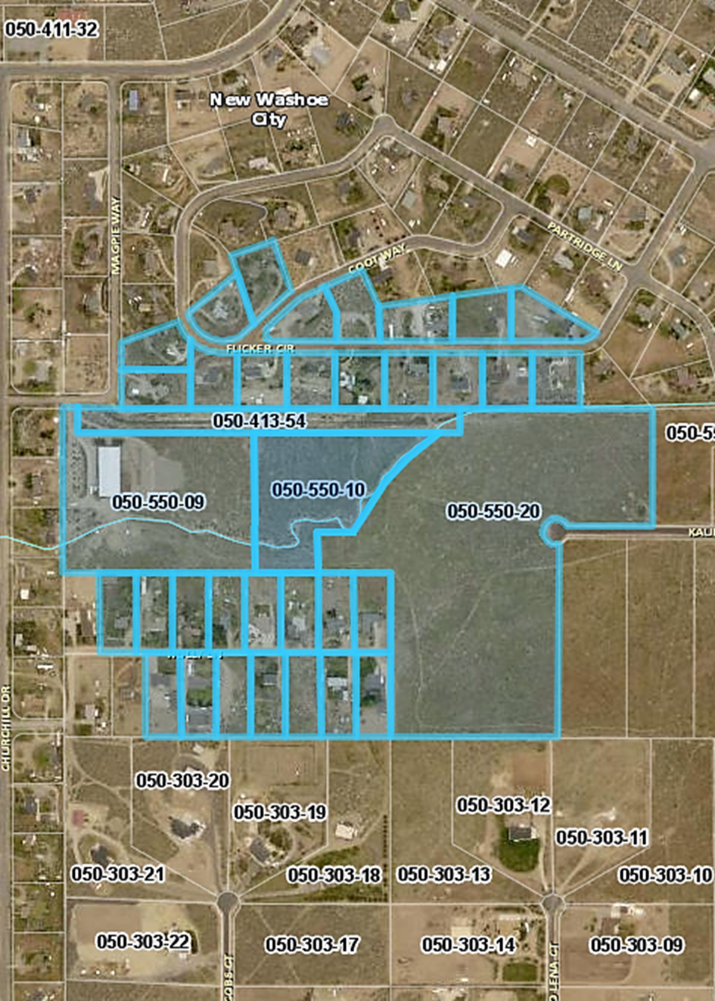
Public Notice & CAB
Notice sent to 36 affected property owners
The attached CAB voted to recommend approval of the permit. One member of the CAB noted specifically that he hopes that the BOA will take into consideration that the SUP process is the means by which restoration and compliance take place.

Slide 7
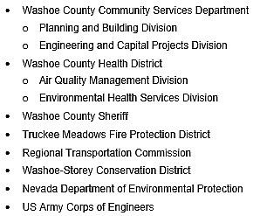
Reviewing Agencies

Slide 8
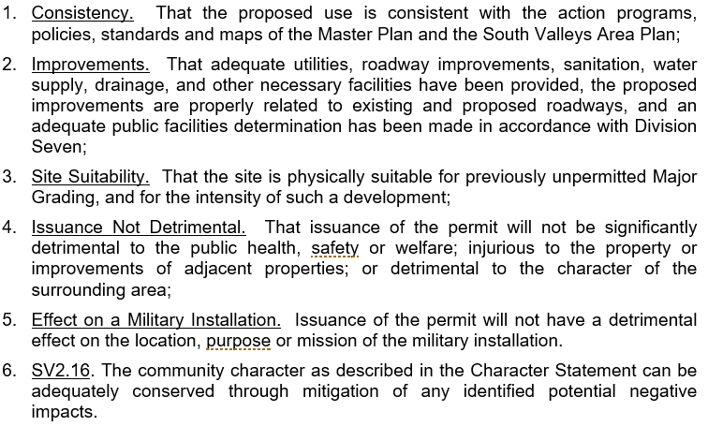
Special Use Permit Findings
Staff Comments on Page 7 of Staff Report

Slide 9
Recommendation
After a thorough analysis and review, Special Use Permit Case Number WSUP20-0023 is being recommended for approval with conditions.

Slide 10
Possible Motion
I move that, after giving reasoned consideration to the information contained in the staff report and information received during the public hearing, the Washoe County Board of Adjustment approve with conditions (included at Exhibit A to the staff report) Special Use Permit Case Number WSUP20-0023 for Burns Family Trust, having made all five findings in accordance with Washoe County Code Section 110.810.30 30 and one finding in accordance with the South Valleys Area Plan.

